Slide 1
Software Engineering
LECTURE 2: Introduction to SW Engg.

Slide 2
What is Software Engineering
Engineering discipline that is concerned with all aspects of software production.
S/W Engg. must understand the customer’s business needs and design software to help them.
Thus, SW engineering task requires:
  Ability to quickly learn new and diverse disciplines and business processes
  Ability to communicate with domain experts, extract an abstract model of the problem, and formulate a solution.
  Ability to design the software systems for the proposed solution to meet the business needs for many years.

Slide 3
The Role of Software Engg.
Software engineering is often confused with Programming
S/W engineering is the creative activity of understanding the business problems, coming up with an idea for solution, and designing the ‘blueprints’ of the solution.
Programming is the craft of implementing the given blueprints

Slide 4

The Role of Software Engg.
A bridge from customer needs to programming implementation
Customer
Software Engineering
Programmer
First law of software engineering
Software engineer is willing to learn the problem domain
(problem cannot be solved without understanding it first)
Notes:
"You cannot solve it, unless you understand it."

Slide 5
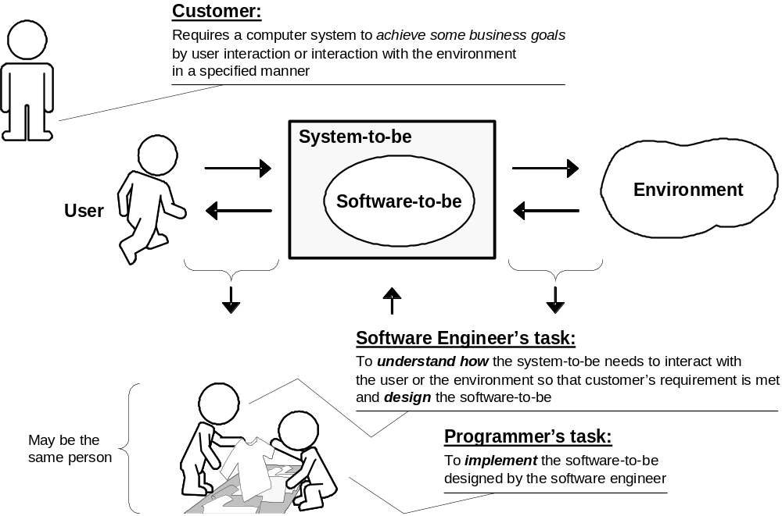
The Role of Software Engg.

Slide 6
The Role of Software Engg.
Some people say: “SW engineering is about writing loads of documentation”
Other people say: “SW engineering is about a running code”
It is neither one!
SW Engg. is helpful to document the process (not the final solution) to know what alternatives were considered and why particular choice were made.
SW Engg. is about delivering value for the customer, and both code and documentation are valuable.

Slide 7
Introduction: Software is Complex
Complex
≠
Complicated
Complex = composed of many simple parts
related to one another
Complicated = not well understood, or explained

Slide 8




Complexity Example:
Scheduling Fence Construction Tasks
Setting posts
[ 3 time units ]
Cutting wood
[ 2 time units ]
Nailing
[ 2 time units for unpainted;
3 time units otherwise ]
Painting
[ 5 time units for uncut wood;
4 time units otherwise ]
Setting posts < Nailing, Painting
Cutting < Nailing
In what order should these tasks be carried out to complete the project
in the shortest possible time?
[ ⇒ “simple” problem, but hard to solve without a pen and paper ]
Notes:
SOURCE: Goodaire & Parmenter, Discrete Mathematics with Graph Theory, Third Edition, Pearson Prentice Hall, 2006. [ Section 11.5, p. 361 ]

Slide 9

More Complexity
Suppose today is Thursday, July 09
What day will be on January 3, 2020 ?
[ To answer, we need to bring the day names and the day numbers into coordination, and for that we may need again a pen and paper ]
Notes:
SOURCE: Hutchins, Cognition in the Wild, The MIT Press, 1995. [ p. 315 ]

Slide 10
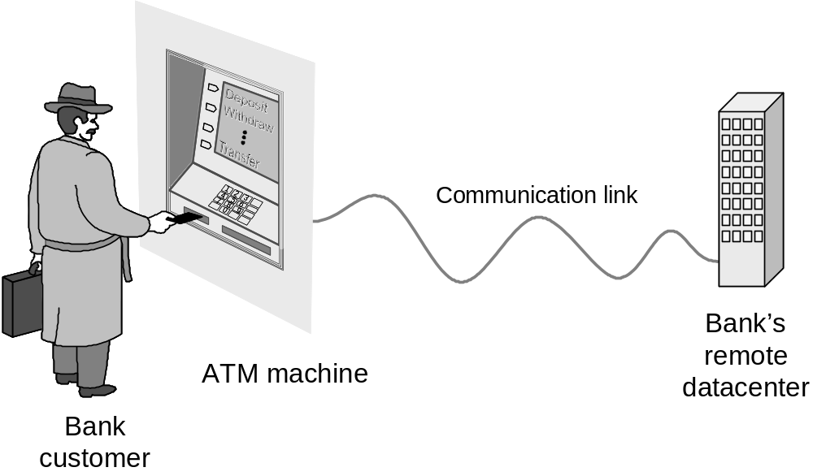
Example: ATM Machine
Understanding the money-machine problem:

Slide 11
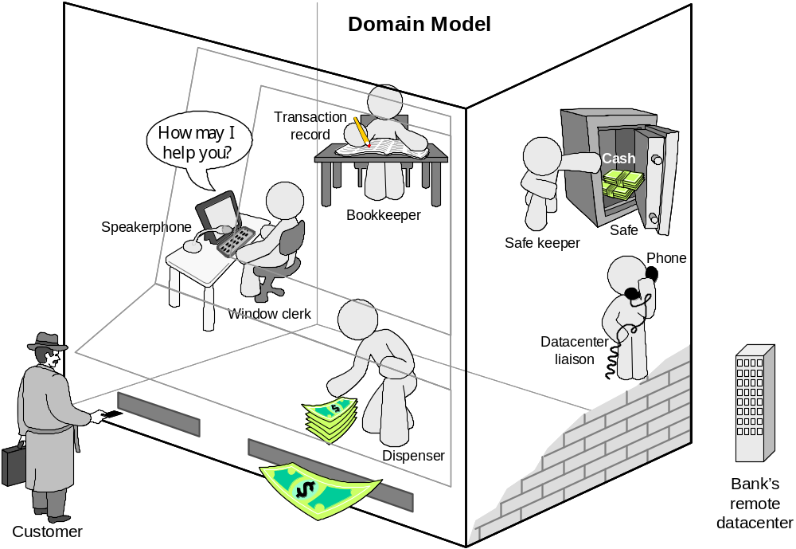
How ATM Machine Might Work
Domain model created with help of domain expert

Slide 12
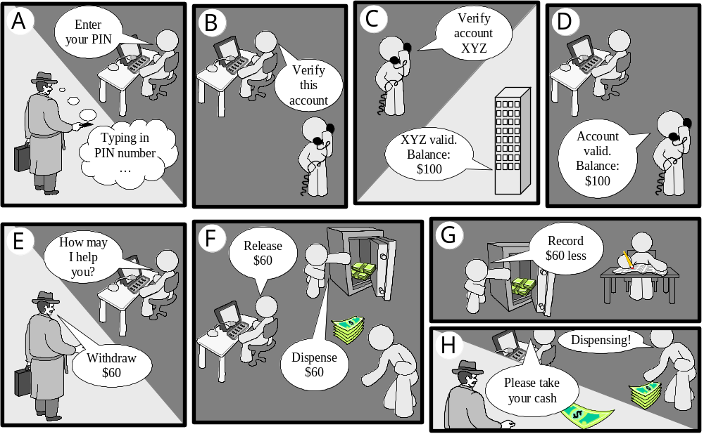
Cartoon Strip: How ATM Machine Works

Slide 13
Software Engineering Blueprints
Specifying software problems and solutions is like cartoon strip writing
Unfortunately, most of us are not artists, so we will use something less exciting: UML symbols

Slide 14
Second Law of Software Engineering
Software should be written for people first
  ( Computers run software, but hardware quickly becomes outdated )
  Useful + good software lives long
  To nurture software, people must be able to understand it

Slide 15
Software Engineering Lifecycle
Any product development usually organized the following phases:
    Planning/specification
    Design
    Implementation
    Evaluation
The common software development phases are:
    Requirement specification
    Design
    Implementation (encoding design in a programming language)
    Testing (unit /integration testing)
    Operation and Maintenance (running the systems, fixing bugs, adding new features)

Slide 16
Software Development Methods
Method = work strategy
    The Feynman Problem-Solving Algorithm:
      (i) Write down the problem
      (ii) think very hard, and
      (iii) write down the answer.
Waterfall
    Unidirectional, finish this step before moving to the next
Iterative + Incremental
    Develop increment of functionality, repeat in a feedback loop
Agile
    User feedback essential; feedback loops on several levels of granularity

Slide 17
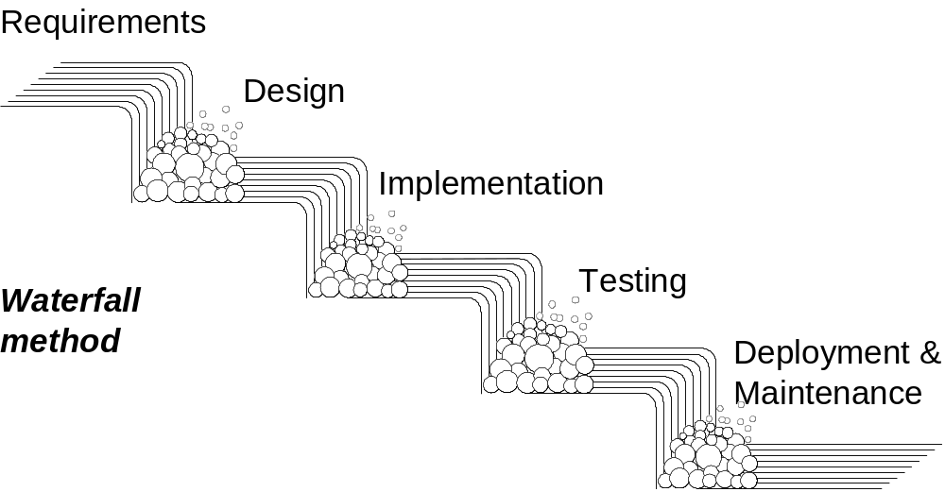
Waterfall Method
Unidirectional, no way back
finish this step before moving to the next

Slide 18
Symbol Language
Communicate ideas is essential as part of a design process.
Diagrams and symbols are indispensible to the software engineering.
A standard symbol language used for modeling in software engineering is UML (Unified Modeling Language)
Modeling is the designing of software applications before coding.
Modeling is an Essential Part of large software projects, and helpful to medium and even small projects as well.

Slide 19
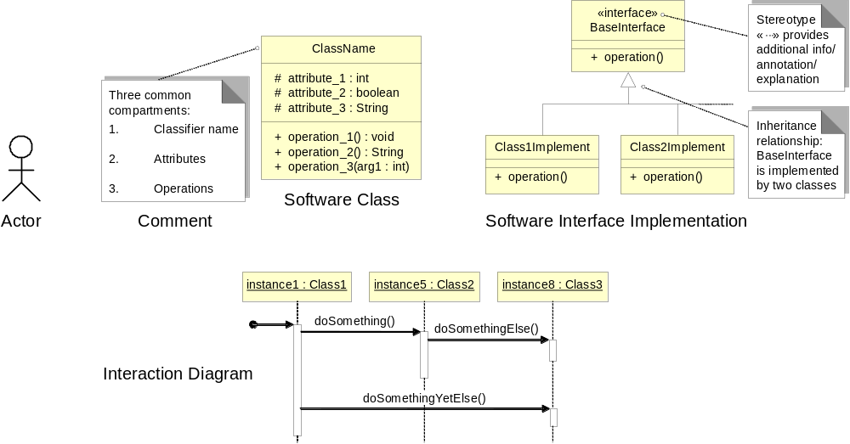
UML – Language of Symbols
UML = Unified Modeling Language
Online information:
http://www.uml.org

Slide 20
Understanding the Problem Domain
The first step in the software development process is called requirement analysis.
Developer attempts to understand the problem and delimit its scope.
    Actors
      Agents external to the system
    Concepts/ Objects
      Agents working inside the system
    Use Cases
      Scenarios for using the system

Slide 21
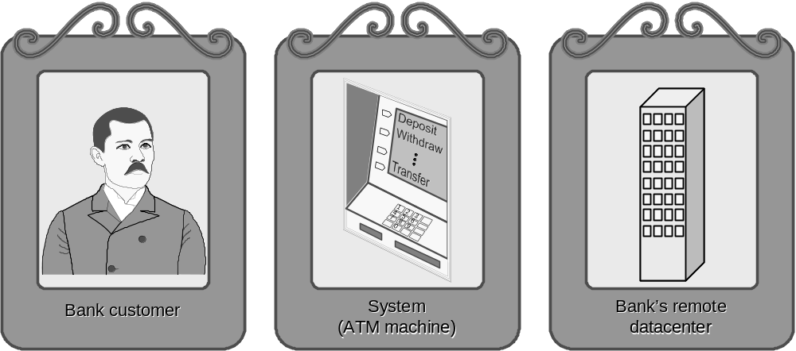
ATM: Gallery of Players
Actors
(Easy to identify because they are visible!)

Slide 22
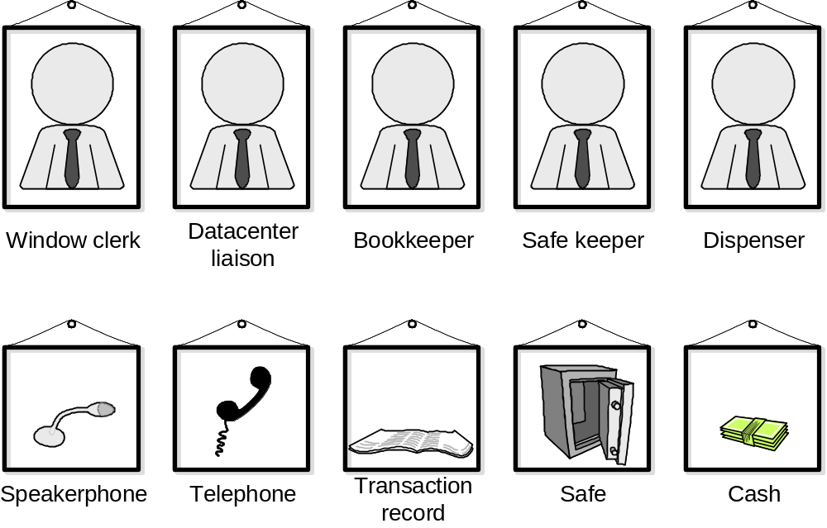
Gallery of Workers + Things
Concepts
(Hard to identify because they are invisible/imaginary!)

Slide 23
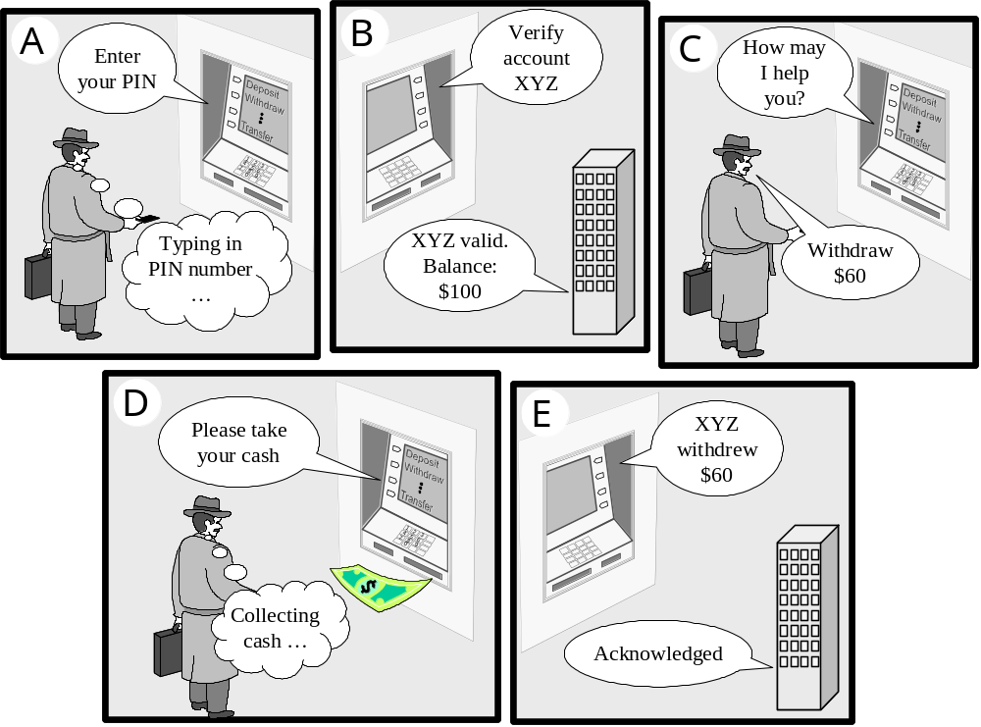
Use Case: Withdraw Cash

Slide 24
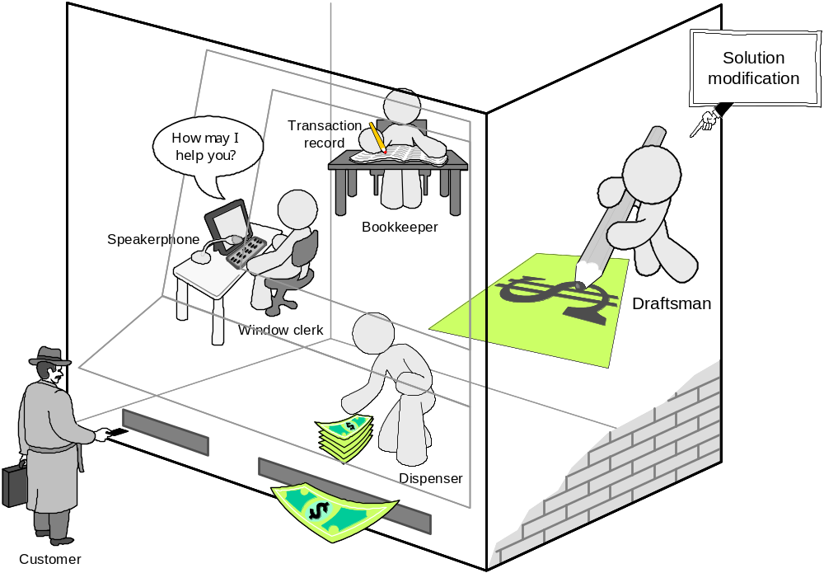
How ATM Machine Works (2)
Domain Model (2)
Alternative solution

Slide 25
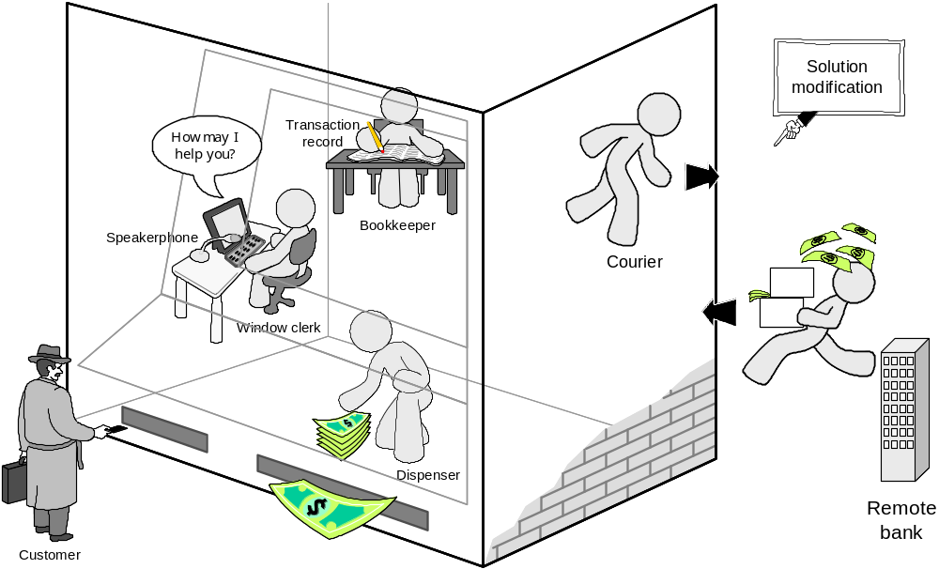
How ATM Machine Works (3)
Domain Model (3)
Alternative solution
Which solution is the best or even feasible?

Slide 26
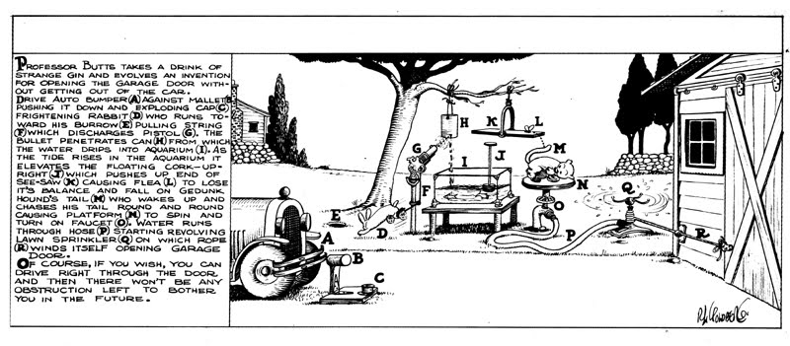
Rube Goldberg Design
Garage door opener

Slide 27
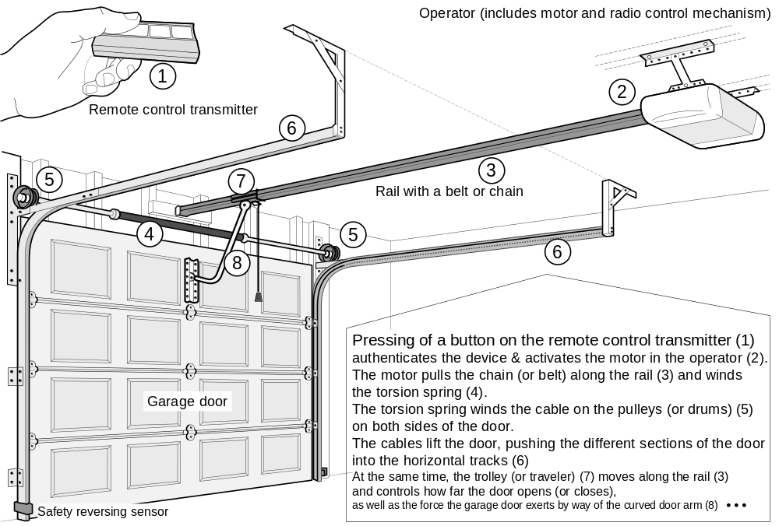
Actual Design

Slide 28
Some Observation !
What makes the latter design realistic and what is lacking in the former design?
Some observations:
The Rube Goldberg design uses complex components (the rabbit, the hound, etc.) with many unpredictable or uncontrollable behaviors; conversely, a realistic design uses specialized components with precisely controllable functions.
The Rube Goldberg design makes unrealistic assumptions, such as that the rabbit will not move unless frightened by an exploding cap.
The Rube Goldberg design uses unnecessary links in the operational chain.

Slide 29
Software Design
Recurring issues of software design include:
  Design quality evaluation
  Design for change
  Design for reuse

Slide 30
Software Measurement
What to measure?
  Project (developer’s work),
  for budgeting and scheduling
  Product,
  for quality assessment

Slide 31
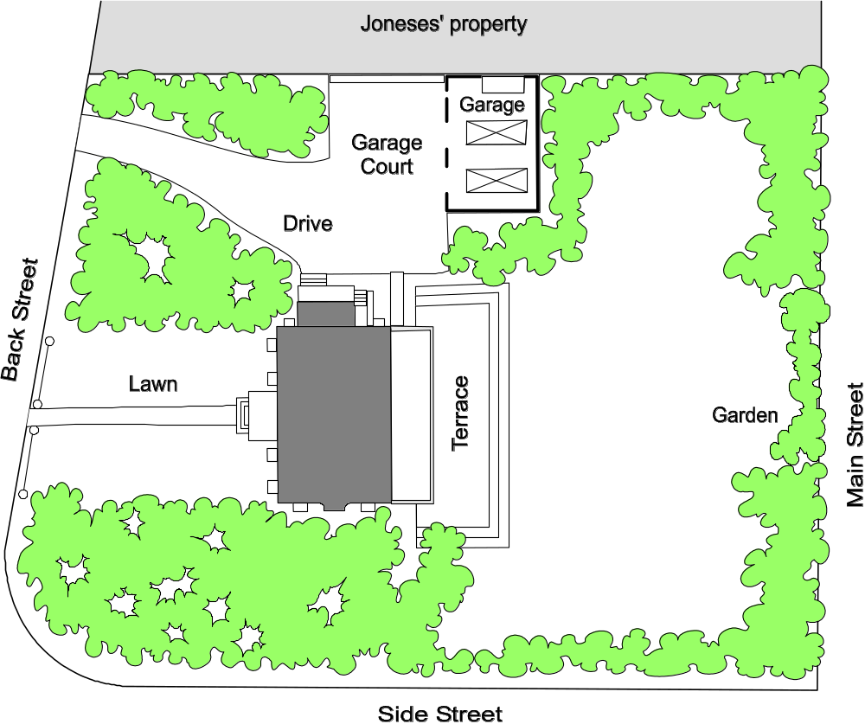
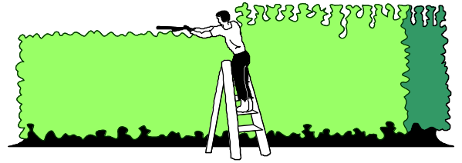
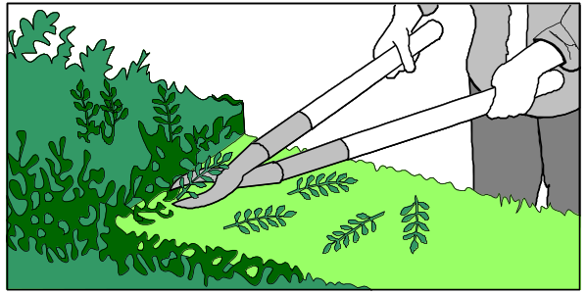
Formal hedge pruning
Effort Estimation and Quality measurement

Slide 32
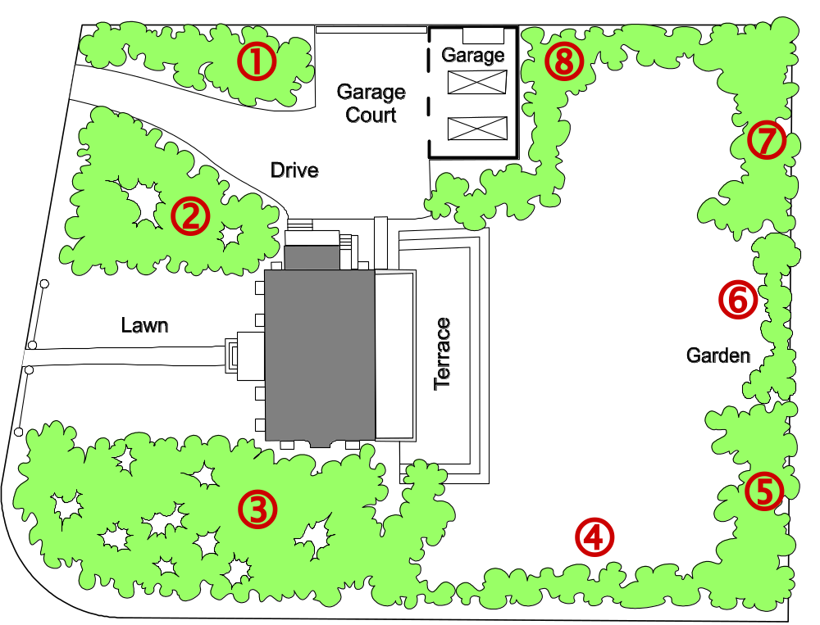
Sizing the Problem (1)
Step 1: Divide the problem into small & similar parts
Step 2:
Estimate relative sizes of all parts
Size(  ) = 4
Size(  ) = 7
Size(  ) = 10
Size(  ) = 3
Size(  ) = 4
Size( □ ) = 2
Size(  ) = 4
Size(  ) = 7

Slide 33
Sizing the Problem (2)
Step 3: Estimate the size of the total work
Total size = Σ points-for-section i (i = 1..N)
Step 4: Estimate speed of work (velocity)
Step 5: Estimate the work duration
Travel duration =
Path size
Travel velocity

Slide 34
Sizing the Problem (3)
Advantages:
  Velocity estimate may need to be adjusted (based on observed progress)
  However, the total duration can be computed quickly (provided that the relative size estimates of parts are accurate – easier to achieve if the parts are small and similar-size)

Slide 35
Exponential Cost of Estimation
100%
Estimation accuracy
Estimation cost
Improving accuracy of estimation beyond a certain point requires huge cost and effort (known as the law of diminishing returns)
In the beginning of the curve, a modest effort investment yields huge gains in accuracy

Slide 36
Estimation Error Over Time
Estimation
error
Requirements
Design
Implementation
Start
Completion
Time
The cone of uncertainty starts high and narrows down to zero as the project approaches completion.
Notes:
Barry Boehm, Software Engineering Economics, Prentice-Hall, 1991.

Slide 37
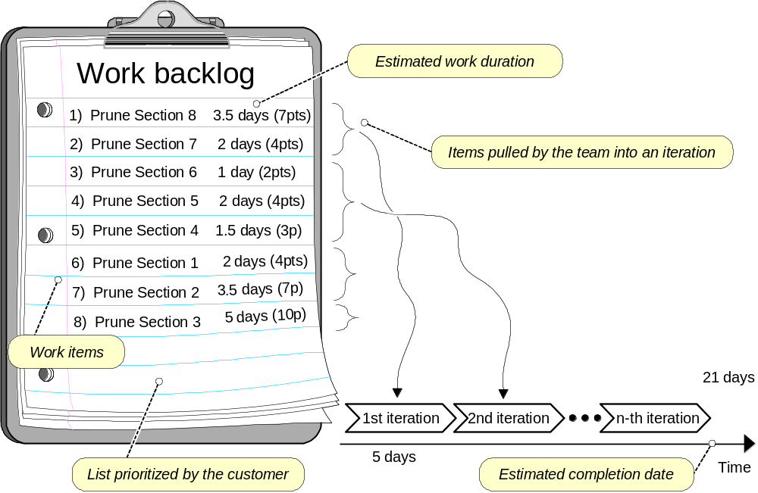
Agile Project Effort Estimation

Slide 38
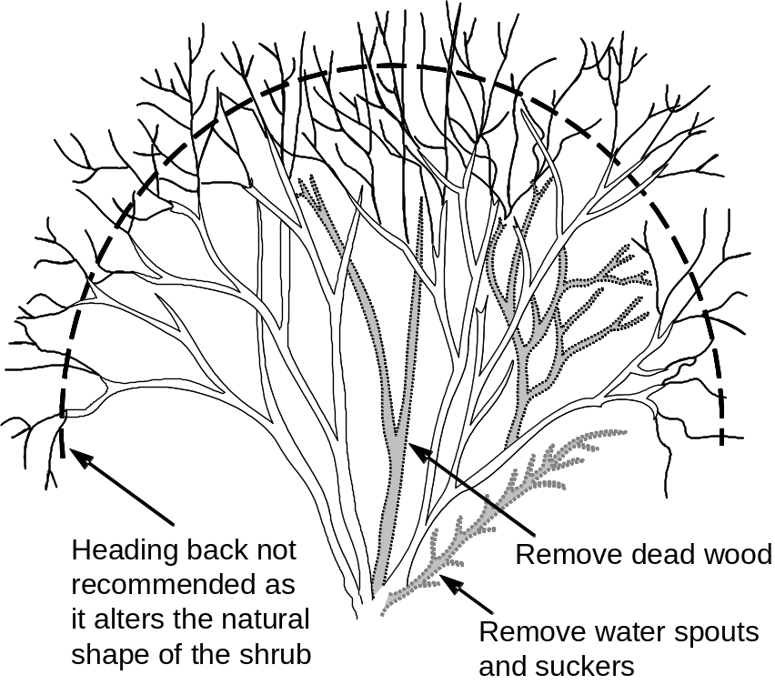
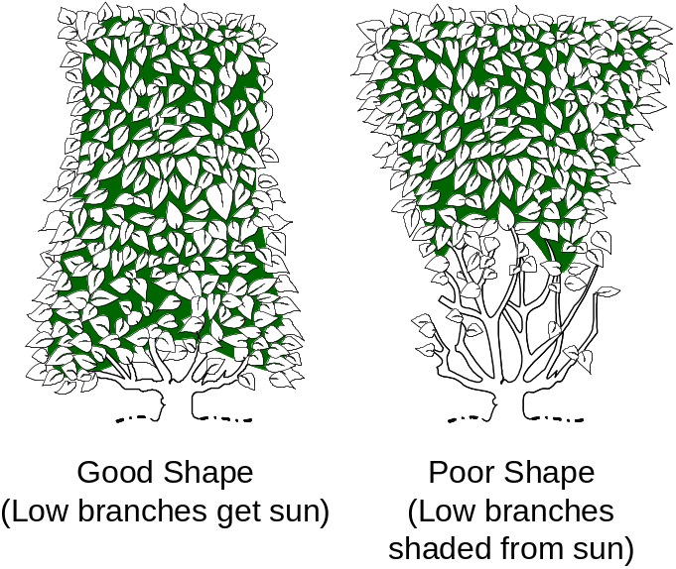
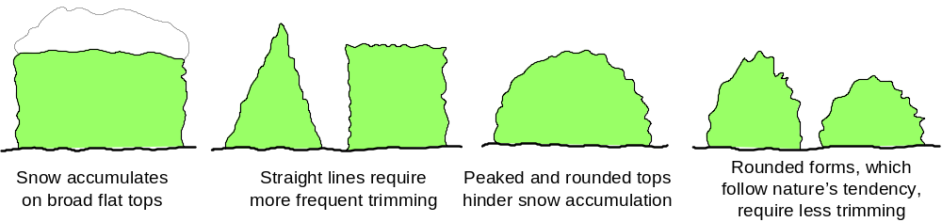
Measuring Quality of Work

Slide 39
Conceptual Maps
Concept maps are graphical tools for organizing and representing knowledge. They include concepts, usually enclosed in circles or boxes of some type, and relationships between concepts indicated by a connecting line linking two concepts.
How to build a concept map:
Start with a main idea, topic, or issue to focus on.
Then determine the key concepts
Finish by connecting concepts--creating linking phrases and words

Slide 40
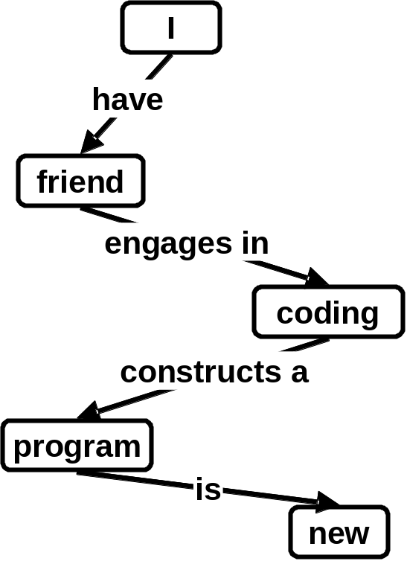
Concept Maps
Useful tool for problem domain description
SENTENCE: “My friend is coding a new program”
translated into propositions
Proposition | Concept | Relation | Concept
1. | I | have | friend
2. | friend | engages in | coding
3. | coding | constructs a | program
4. | program | is | new
Search the Web for Concept Maps

Slide 41
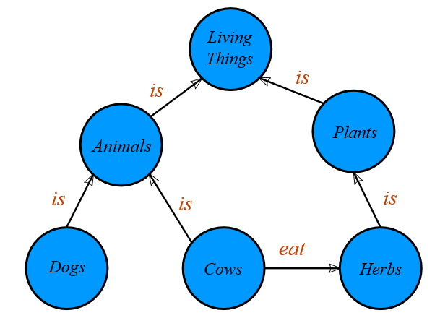
Conceptual Maps

Slide 42
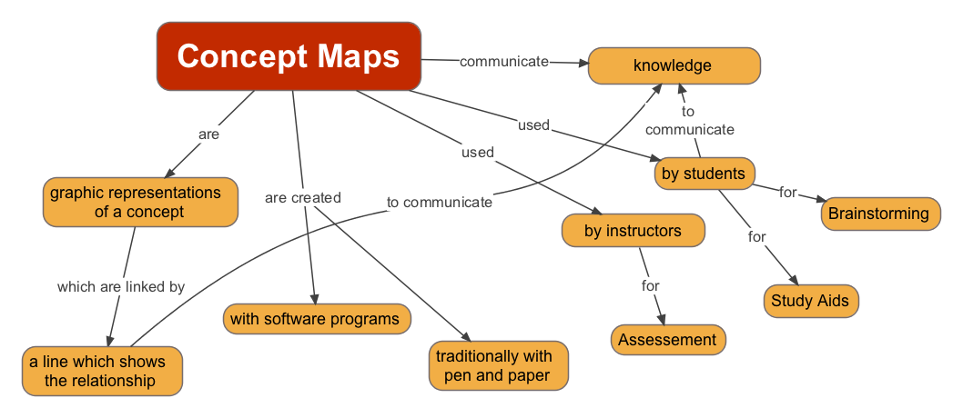
Conceptual Maps

Slide 43
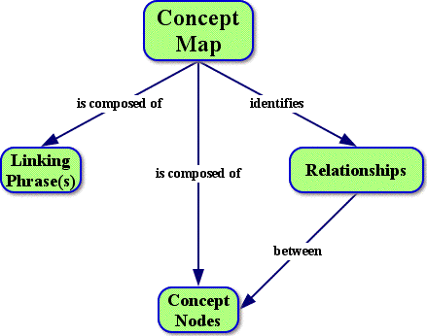
Conceptual Maps

Slide 44
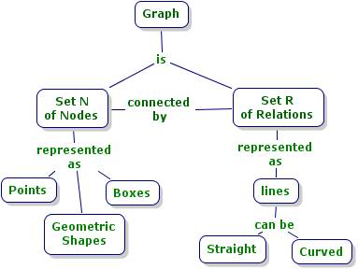
Conceptual Maps

Slide 45
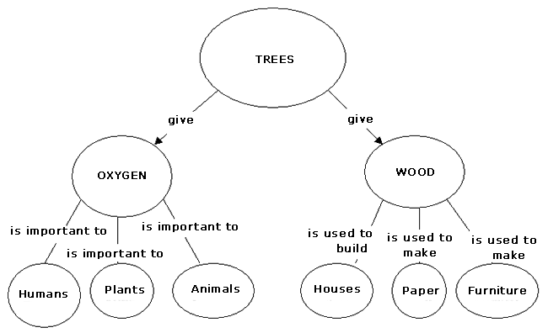
Conceptual Maps

Slide 46
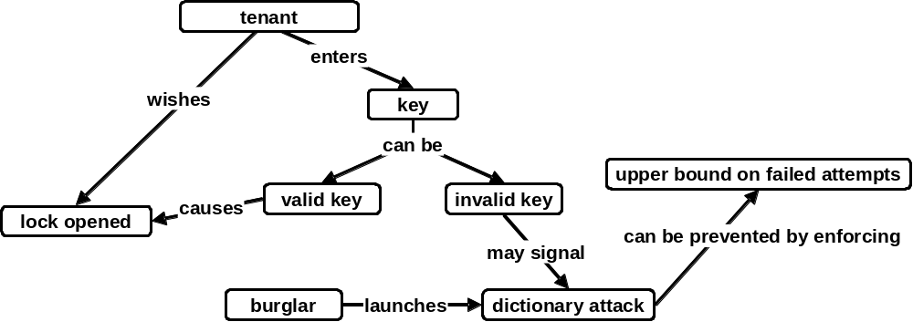
Concept Map for Home Access Control

Slide 47
States and Transition Rules
IF validKey AND holdOpenInterval THEN unlock
IF validKey THEN unlock
locked
unlocked
IF pushLockButton THEN lock
IF timeAfterUnlock ≥ max{ autoLockInterval, holdOpenInterval } THEN lock
… what seemed a simple problem, now is becoming complex

Slide 48
Conceptual Maps
Benefits of Concept Mapping
Help for brainstorming and generating new ideas
Encourage to discover new concepts and the propositions that connect them
Allow to more clearly communicate ideas, thoughts and information
Help to integrate new concepts with older concepts
Help to gain enhanced knowledge of any topic and evaluate the information

Slide 49
Practicing!!!
Draw a Concept Map for MIST admission process

